Slide 1

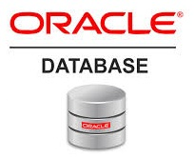
Oracle database
Lecture 15

Slide 2

Today’s Agenda
Introduction To GROUP Functions
Types Of GROUP Functions
Introduction To MISCELLANEOUS Functions
Types Of MISCELLANEOUS Functions

Slide 3
Group Functions
Group functions are built-in Oracle functions that operate on groups of rows and return one value for the entire group.
So instead of operating on one row at a time and returning the result , they operate on a set of rows and return one result for the entire set.
Due to this behaviour they are also called aggregate functions

Slide 4
Group Functions
These functions are:
SUM
MAX
MIN
AVG
COUNT

Slide 5
The Function SUM ()
This function returns the sum of the values of a numeric column without considering NULL values
Syntax
SUM(col_name or expr)
Arguments:
Col_name or expr : This is the column name on which the function will be applied. We also can pass the an expression which results into a numeric value

Slide 6
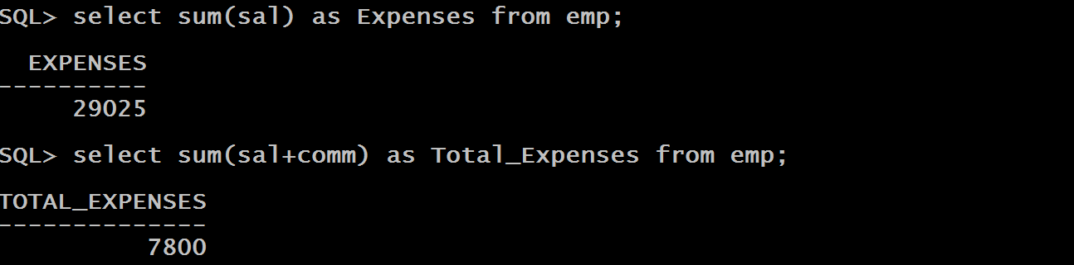
Examples

Slide 7
The Function AVG ()
This function returns the average of the values of a numeric column without considering NULL values
Syntax
avg(col_name or expr)
Arguments:
Col_name or expr : This is the column name on which the function will be applied. We also can pass the an expression which results into a numeric value

Slide 8
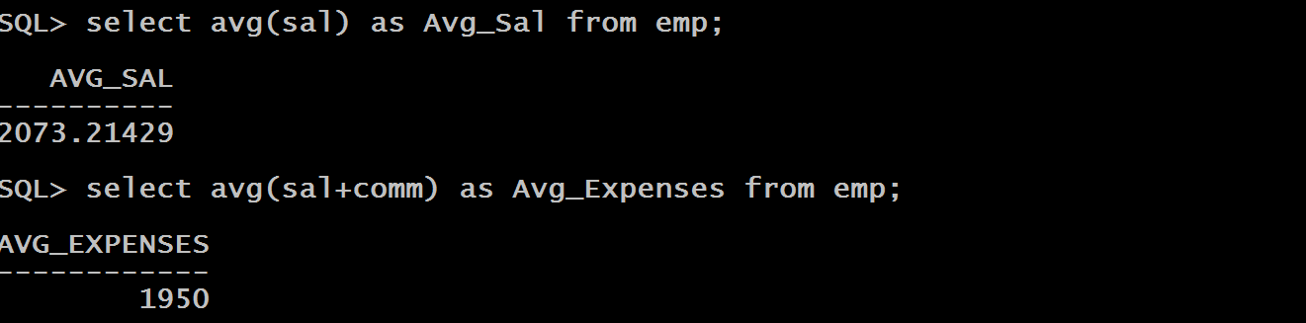
Examples

